Slide 1

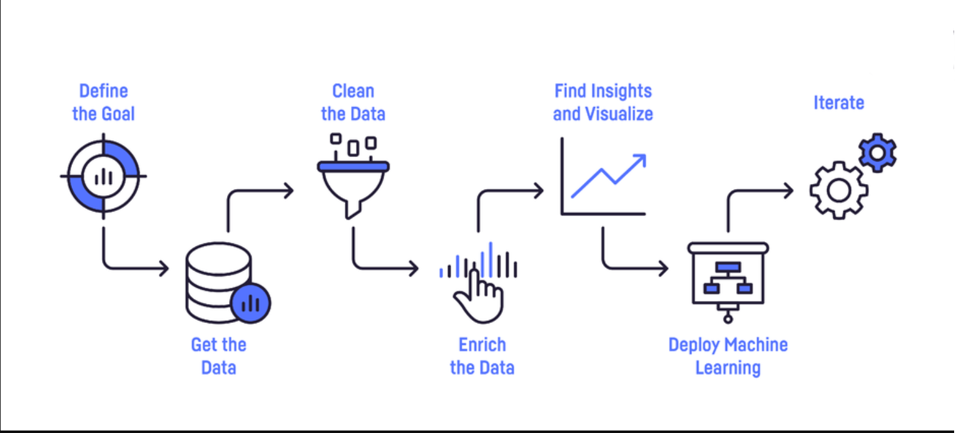

Project Steps:

Slide 2
Project Question:
Given player statistics, Can we anticipate his rank?
GitHub
By: Yarin Shelek & Or Sharvit

Slide 3
Data Crawling

Slide 4
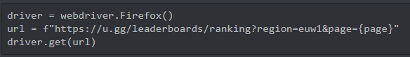
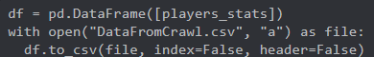
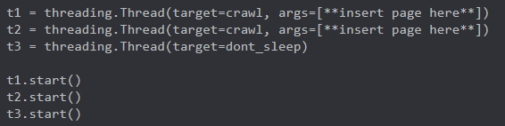
Libraries used for crwaling:
Selenium, Pandas and Threading were the main 3 moduels we used.
We used selenium to run over the site (u.gg)
and inserted the data into a pandas data frame, which we then rendered into our data file.
We multi-threaded the crawling process (3 threads, 2 for selenium, one for a no-sleep function). as it took quite a while (on 2 pcs as well),
Starting from different page stamps, making the process a lot faster than it should have been. (in the github, it shows only our latest run, which was only on 37800+, as we wanted to get more low ranked players, but this is the code we used for 2 simultaneous runs)
Please note: this is only a fraction of the code, as the real code is over 150 lines...

Slide 5
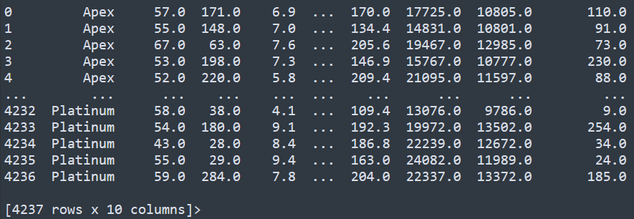
After merging our data, we ended up having: (6061, 11) = 66,671 overall data.
After the (FULL – including the mass reduction in data we did [more info later]) cleaning process, we ended with: (4237, 10) = 42370 overall data.
Head:

Slide 6
In this project, we decided to crawl U.gg, which is a site that has many statistics about the game "League of Legends", and in particular, it has data for each ranked player in the server (we chose euw as our data resource). In order to get the data, we crawled their website, as they serve no API. When we tried to use BeautifulSoup, we realized the site was not giving us the correct html, and we realized it was being generated by JS. After a brief research online we learnt about selenium, and that it is the solution to our problem. We learnt how to use selenium and went ahead and used it. The site was pretty aggressive towards our crawling, blocking us many times (when they did we just made our program refresh the page until it was ready) and we ended up multi-threading the crawl in order to increase our data accumulation rate. In the end, this is the original data we have acquired (Clickable):

Slide 8
Data Cleaning

Slide 9
To begin cleaning our data, we got rid of all the players who do not have a rank. We have removed duplicated rows that were created from the crawling(since we ran it simultaneously).
After that, we have identified and classified outliers:
1. Players that are "smurfs"(have more than 75% win-rate with less than 100 games)
2. Players that are "no-lifers"(Have more than 1500 games)
3. Players that are "trolls"(Have a very low win-rate, less than 30%)
In addition, we tried to improve our model accuracy with different approaches of data cleaning(Some of them are Niv Bar ideas):
to "normalize" the sizes of our ranks, which means to equal the number of data we have from each rank - this was Niv's idea and it helped to improve the accuracy.
2. In general, we tried and played with different math calculations that made sense In the columns which had high correlation, to create new columns which will hopefully improve our accuracy.
3. We combined our top 3 ranks: Challenger, Master and GrandMaster. That’s because the game classifies those 3 ranks as “Apex” and because they truly have minor differences between them, we did the same to our bottom 2 ranks: Iron and Bronze. The reason for that was that iron was very rare, and honestly there was just no point in having iron as a standalone rank, as only very new players are in that rank, and in our opinion - they are irrelevant. This also improved our accuracy drastically.
Most of the ideas we tried(and we tried a lot) did not improve our accuracy and even made it worse.

Slide 10
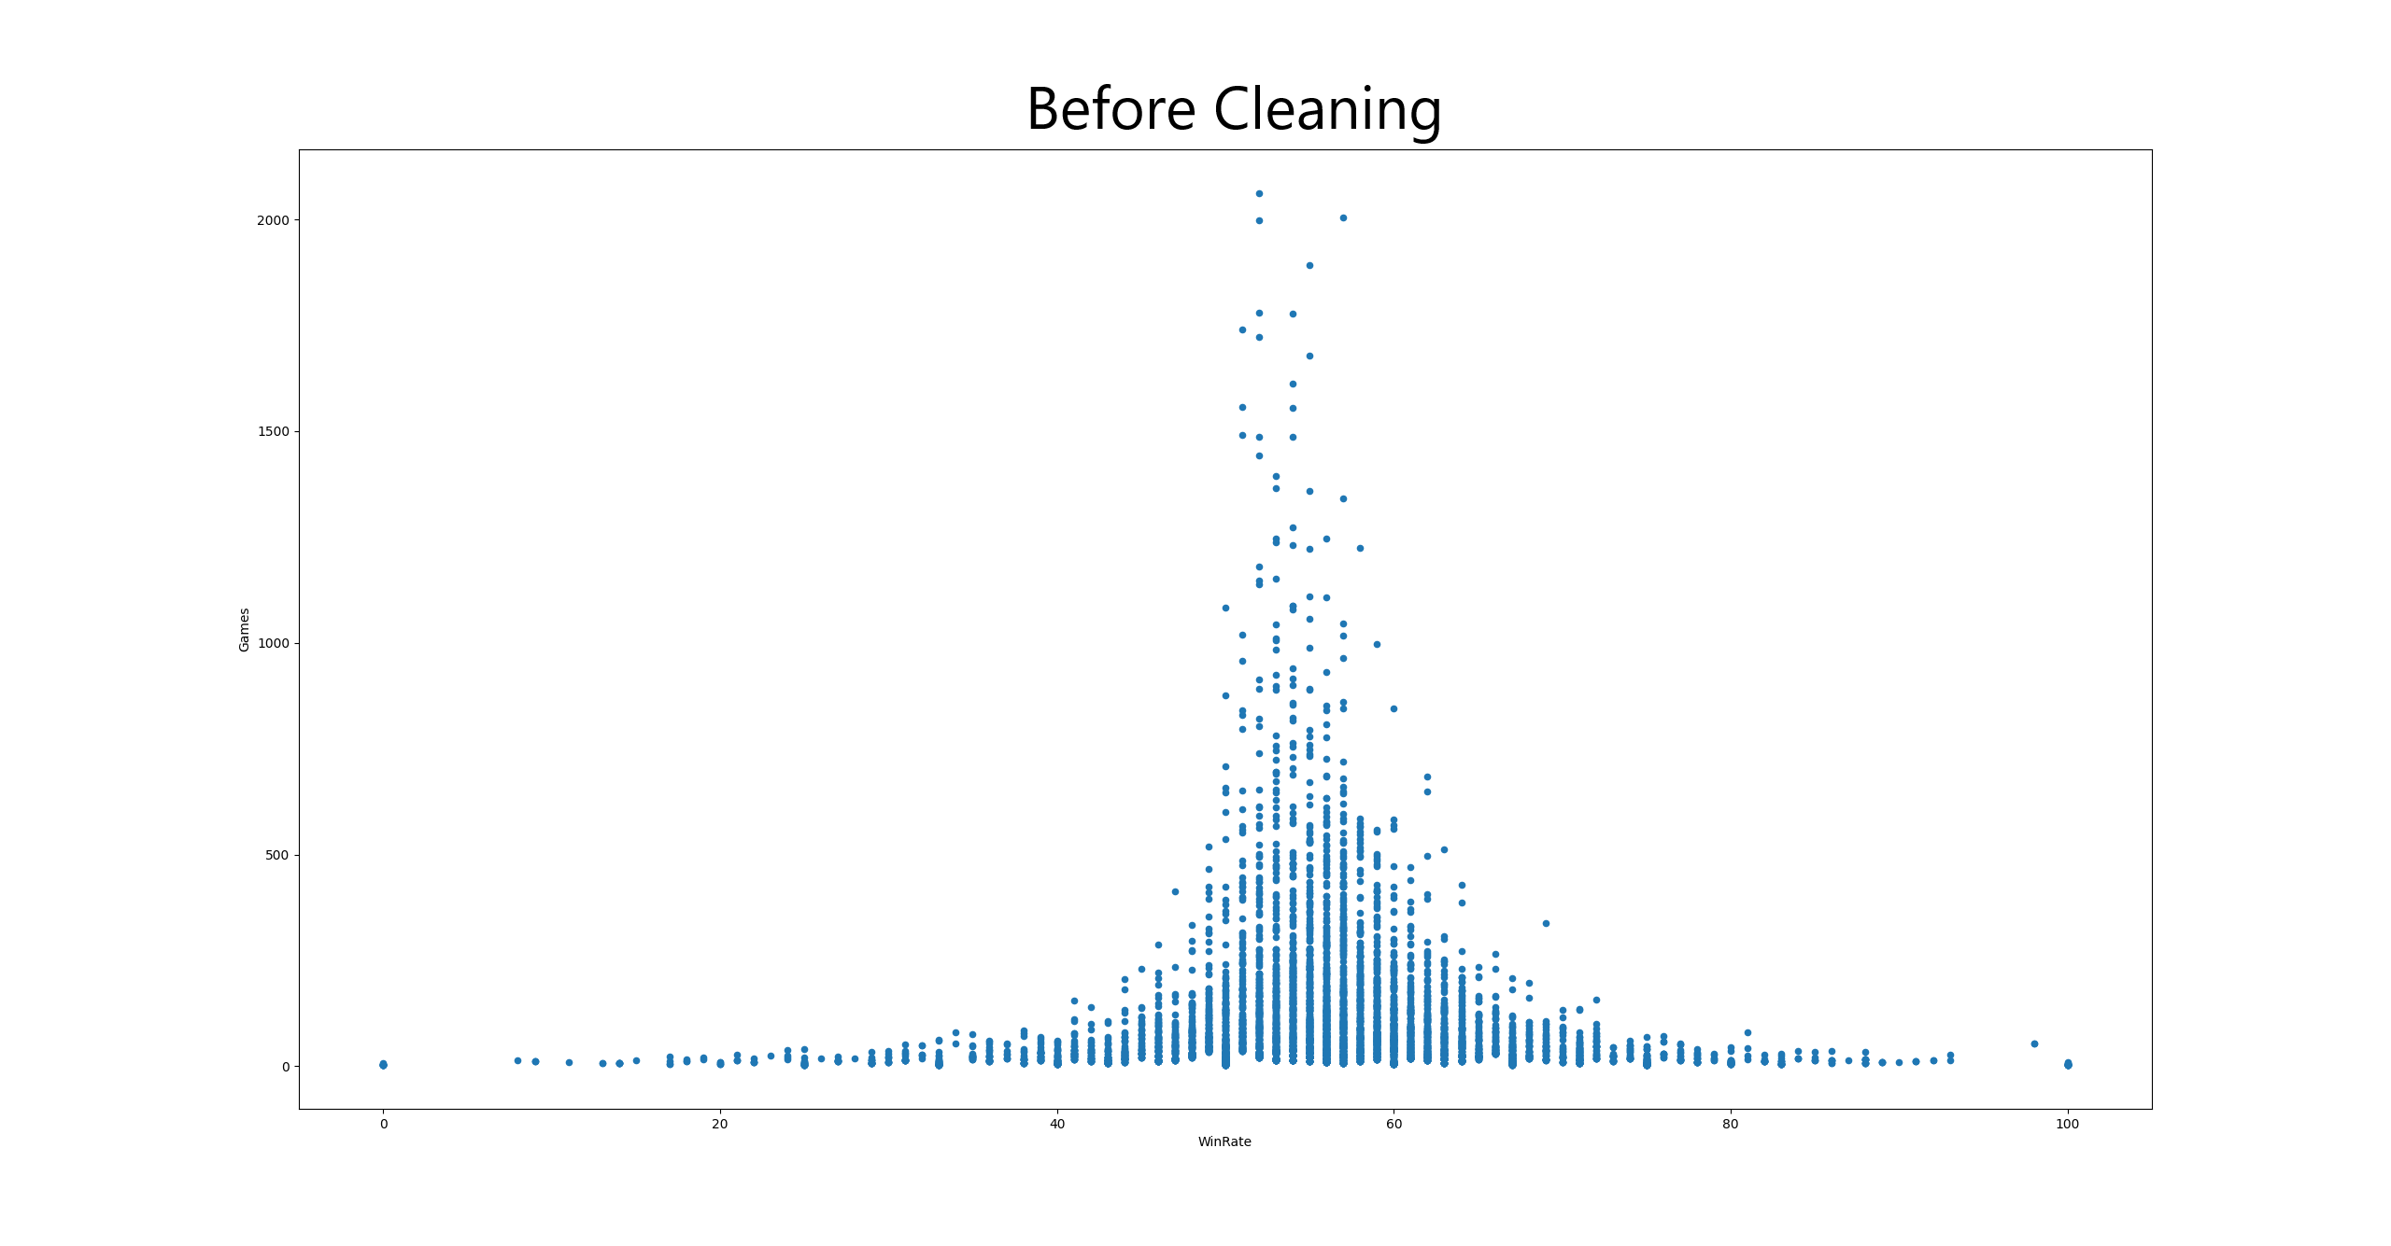

Slide 11
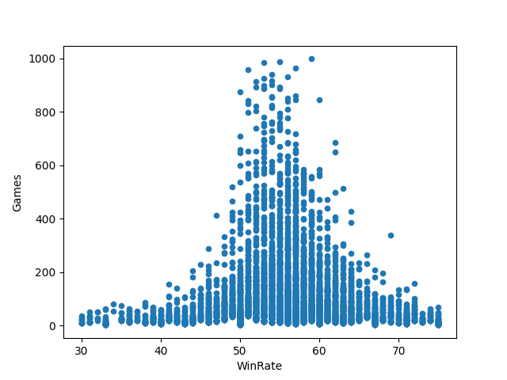
After Cleaning

Slide 12
EDA AND VISUALIZATION

Slide 13
In this step, we wanted to further explore our data to see the correlations between our columns and to better understand the data we were dealing with.
We started by printing out the correlation matrix to see which columns we would like to focus on.
As we pointed out earlier in the data cleaning section, after getting the results from visualizing the columns and the correlation matrix, we have tried many different manipulations as stated in the data cleaning section. Sadly, none of them proved useful, and only worsened our model in the long run.
on our dataset which did not help.
Here is what we found:

Slide 14
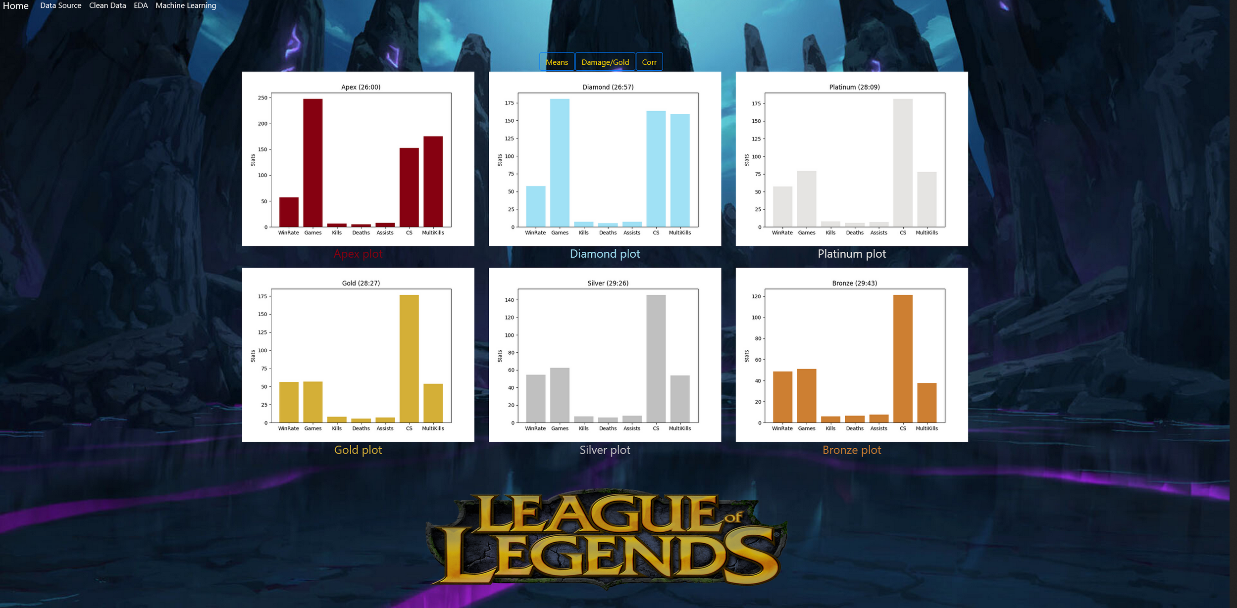
Column Means
(Parentheses include
average time per game
for each rank)

Slide 15
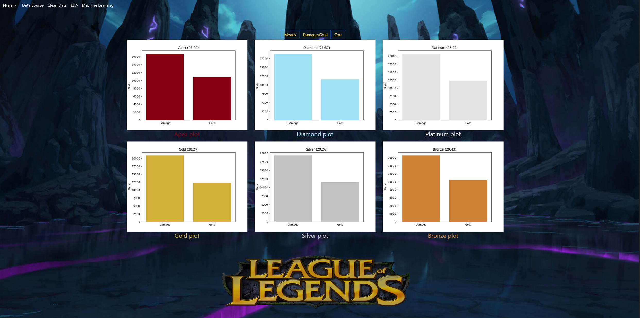
Damage / Gold Means

Slide 16
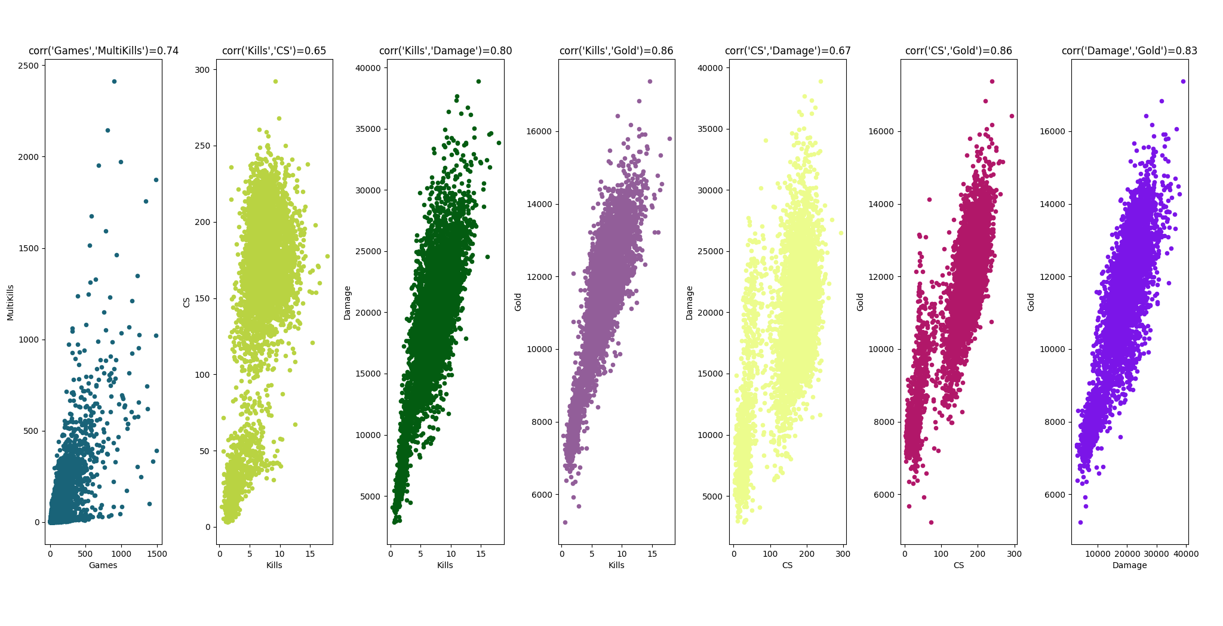
Pearson correlation method to plot high correlated columns

Slide 17
Machine Learning

Slide 18
The main theme of this project is to predict a certain player’s rank, given his statistics.
To do that we have collected our data, and trained a model using it.
At the start, we had a really low accuracy score(around 20%).
To fix that, we have tried various things which lead to a better result:
We trained our model with every machine learning algorithm that the sklearn module had to offer that matched our needs and compared between them:
Naive Bayes: Lead to the worst results: f1 - 0.37, acc - 0.4
KNN: We used GridSearchCV to find the best K neighbors for the model, which was 19, which lead to the following results: f1 – 0.397, acc - 0.425
Decision Tree: We used GridSearchCV to find the best max depth and min sample split which were: 8, 13 respectively, which lead to the following results: f1 - 0.423, acc - 0.433

Slide 19
Random Forest: We used GridSearchCV to find the best K neighbors which was 13 and lead to the following results: f1 – 0.438, acc - 0.45.
Support Vector Classifier: lead to the results: f1 - 0.457, acc - 0.496.
Neural Networks: This was by far the best algorithm to train our model with (we also used it to train our chosen model that we use to predict a player’s rank).
It lead to the following results: f1 – 0.497, acc – 0.514.
2. As we said in previous chapters – we combined the top 3 ranks into a single rank and did the same thing to the 2 bottom ranks.
3. We realized we have been overfitting our model over the gold and platinum ranks, as we had much more data on them than the other ranks did, So we got rid of many of them using the IQR detection method.

Slide 20
4. We also realized that the “KDA” column was hurting our model quite a lot, so we decided to get rid of it too.
After those steps, we managed to improve our model from the disappointing 20% to a less disappointing 51.4% accuracy, which is acceptable by us considering guessing a player’s rank based on purely statistics, can be very tricky as the game is not only about statistics but also raw player skill, making it hard for even us humans to predict.

Slide 21
“All part of a plan I just made up”
-Jinx
Or & Yarin

